Slide 1
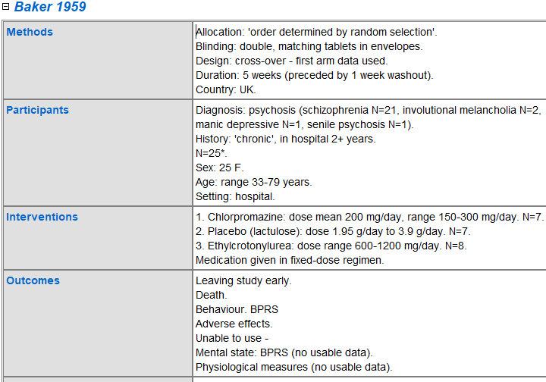
Extracting large sets of data from systematic reviews:
developing a basis for extracting, storing and using
information on trials
Bachelorthesis SS 2018
Lena Schmidt
Project partner:
Background
To this day, the Cochrane Schizophrenia Group (CSG) produced and maintained 224 systematic reviews (SR). Their SR contain qualitative and quantitative data of more than 2800 clinical trials, mostly extracted by the hands of volunteers over the course of 24 years. These data are usable only in the context of a SR and with access to the Cochrane Library.
In the public health sector, open access and sharing of clinical research data is a topic which is currently demanded, encouraged, but also criticised. An opportunity how the Cochrane Collaboration can contribute by sharing their data is discussed in this dissertation.
ReviewManager5 files
File backend
Tidy XML
Research question
To which extend is it possible to
automatise extraction of trial data from SR?
analyse and categorise qualitative data?
prepare these data to be used and shared?
Research end-user
Cloud
Results
An app that extracts and analyses all trial data from a list of SR was produced. The app‘s output is a file that can be imported to Excel and Access databases for further analysis.
Aim
This dissertation aims at extracting and saving all trial data from the schizophrenia reviews in an accessible format.
CSG study register
Picture 1: Process and use-cases
randomised
Methodology
An analysis of 15 representative SR was carried out to explore relevant variables that could be extracted, resulting in the five domains below.
Furthermore, the analysis explored description and frasing of the prose-text characteristics variables (e.g. identifying the 11 ways to spell double blind).
Two SR on diagnostic accuracy were excluded because of their structural differences.
The SR were available as ReviewManager5 files. For each variable, a path for extraction from the file‘s XML backend was identified and a Java app was developed to parse, extract, analyse and marshal all variables back to a newly created XML file.
Processing
Using
Regular Expressions
Allocation
double blind
Blinding
crossover
Design
randomised
Characteristics
Methodology:
- Allocation
- Blinding …
Risk of Bias + Judgement
Selection Bias
Bias judgement
Performance Bias
Bias Judgement
Other biases and respective judgements
References
Type of reference
Authors
Title
Journal
Identifiers
Trial level:
- Clin.Trials gov
- DOI …
Reference level:
- PubMed ID
- Embase ID …
Data
Outcome names
Interventions
Subgroups
Participants:
- Diagnosis
- Criteria …
Numeric data, depending on outcome type
Other trial demographics
Other reference-related variables
Other outcome-related variables
Picture 2: “Characteristics of included studies table” from SR and cleaned variables
Discussion
It is possible to automatically extract data on outcomes, references, identifiers and risk of bias for all Cochrane reviews. Data on characteristics are prose, therefore cleaning and categorising here was developed specifically for the schizophrenia reviews and, due to exceptional spelling and frasing, is incomplete in very few cases.
A database with clean and curated data on all available aspects of a trial is available to be used by the CSG and by projects within Cochrane that focus on categorisation and dissemination of evidence. Data on methodology can be queried together the respective bias items, which gives an added value since it helps with interpretation.
Supervisors
Prof. Dr. Kirsten Steinhausen
Prof. Dr. Clive E. Adams
Literature
Pisani, E. and AbouZahr, C. (2010). Sharing health data: good intentions are not enough.
Bulletin of the World Health Organization, 88(6), pp.462-466.
Taichman, D., et al. (2016). Sharing Clinical Trial Data — A Proposal from the International Committee of Medical Journal Editors. New England Journal of Medicine, 374(4), pp.384-386.

